Slide 1
Skating Merit Badge In-Line Skating Option
Troop 344 and 9344
Pemberville, OH

Slide 2
Internet access is necessary for viewing the online tutorials of the various skating skills.
If you are a Scout, please obtain parental permission before viewing the videos.

Slide 3
Skating Merit Badge Requirements
Do the following:
Explain to your counselor the most likely hazards associated with skating and what you should do to anticipate, help prevent, mitigate, and respond to these hazards.
Show that you know first aid for injuries or illnesses that could occur while skating, including hypothermia, frostbite, lacerations, abrasions, fractures, sprains and strains, blisters, heat-related reactions, and shock.

Slide 4
Skating Merit Badge Requirements
Complete ALL of the requirements for ONE of the following options,
In-Line Skating
Do the following:
Give general and in-line skating safety rules and etiquette.
Describe the parts and functions of the in-line skate.
Describe the required and recommended safety equipment.
Describe four essential steps to good skate care.
Do the following:
Skate forward with smooth, linked strokes on two feet for at least 100 feet.
Skate forward and glide at least 15 feet on one skate, then on the other skate.
Stop on command on flat pavement using the heel brake.

Slide 5
Skating Merit Badge Requirements
Complete ALL of the requirements for ONE of the following options,
In-Line Skating
Do the following:
Perform the forward crossover.
Perform a series of forward, linked swizzles for at least 40 feet.
Skate backward for at least 40 feet in a series of linked, backward swizzles.
From a strong pace, perform a lunge turn around an object predetermined by your counselor.
Perform a mohawk.

Slide 6
Skating Merit Badge Requirements
Complete ALL of the requirements for ONE of the following options,
In-Line Skating
Do the following:
Perform a series of at least four one-footed downhill slaloms on pavement with a gentle slope.
Describe how to pass a pedestrian or another skater from behind.
Describe at least three ways to avoid an unforeseen obstacle while skating.
Describe two ways to get on. and off a curb, and demonstrate at least one of these methods.

Slide 7
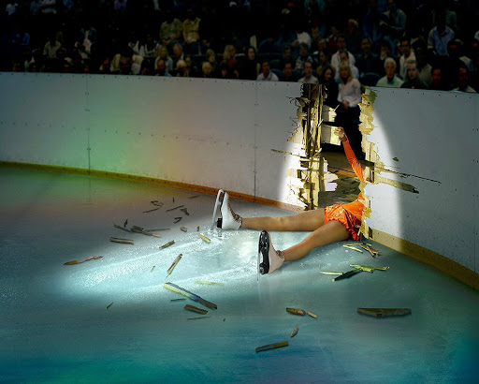
Requirement 1a
Explain to your counselor the most likely hazards associated with skating and what you should do to anticipate, help prevent, mitigate, and respond to these hazards.

Slide 8
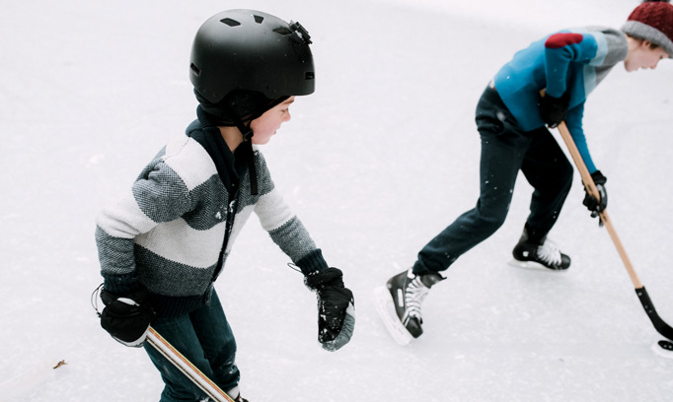
Hazards of Skating
Ankle Sprains & Fractures The intense weight and pressure placed upon the ankles during skating activity makes them susceptible to sprains and fractures.
Head Injuries When a loss of balance or control occurs, head injuries are a common and serious consequence. The ice surface is very dangerous as there is no cushion against impact. These skating injuries may include concussions or other traumatic brain injuries. Wear a helmet!

Slide 9
Hazards of Skating (continued)
ACL Tears The anterior cruciate ligament (ACL) runs diagonally through the middle of the knee and provides rotational stability. A traumatic injury, such as those commonly sustained during ice skating, can cause a tear of the ACL or surrounding menisci.
Lacerations Sharp blades. Hard ice. Speed and precise movements. These combined factors put ice skaters at risk of lacerations of varying degrees of severity.

Slide 10
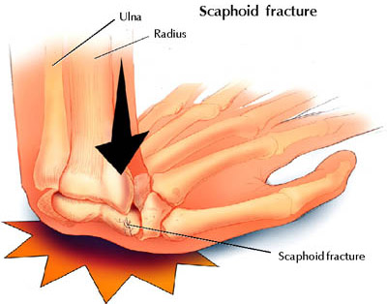
Hazards of Skating (continued)
Hand and Wrist Injuries When we experience a slip or fall, our immediate instinct is to put our hands out to catch ourselves--which is good, because it protects the more important head and face. But it can also result in serious injury to the hand or wrist from the force of the impact.

Slide 11
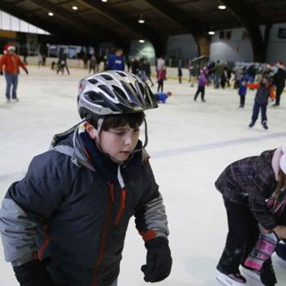
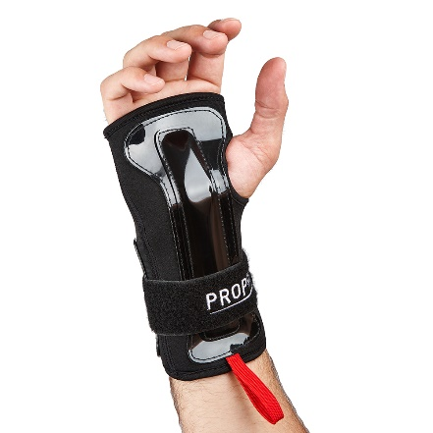
Skating Safety Tips
Proper Equipment Many of the orthopedic skating injuries that are commonly suffered can be prevented by simply wearing proper equipment; that may include padding, helmets, and--of course--quality skates.
Proper Fit Skates that do not fit properly contribute to a high number of skating injuries; they may cause stress to bones, muscles, and ligaments, as well as imbalance.

Slide 12
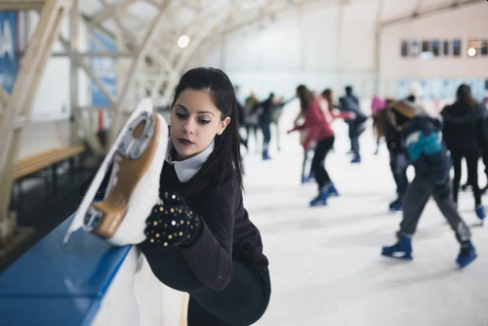
Skating Safety Tips (continued)
Warm Up Thoroughly Cold muscles and ligaments are more brittle and prone to tears and injury. Warming up can help to loosen your muscles, tendons, and ligaments and help to prevent tears.
Avoid Extreme Exposure Wear adequately warm clothing--thick layers and a waterproof shell. And pay attention to changing weather. If you start to feel uncomfortable or chilled, it’s time to end your activity and return to warm shelter.

Slide 13
Requirement 1b
Show that you know first aid for injuries or illnesses that could occur while skating, including hypothermia, frostbite, lacerations, abrasions, fractures, sprains and strains, blisters, heat-related reactions, and shock.

Slide 14
First Aid for Hypothermia
Gently remove wet clothing.
Replace wet things with warm, dry coats or blankets.
If further warming is needed, do so gradually.
For example, apply warm, dry compresses to the center of the body — neck, chest and groin.

Slide 15
First Aid for Frostbite
Warm the frostbitten parts in warm (not hot) water for about 30 minutes.
Place clean cotton balls between frostbitten fingers and toes after they've been warmed.
Loosely wrap warmed areas with clean bandages to prevent refreezing.
Give acetaminophen or ibuprofen for pain.

Slide 16
First Aid for Lacerations
Stop the Bleeding by apply direct pressure on the area if necessary.
Clean the area with warm water and gentle soap.
Apply an antibiotic ointment to reduce chance of infection.
For a minor laceration, remove the bandage after a couple of days to promote healing.
Call a health care provider if:
The cut is deep or over a joint
If the cut doesn't heal or shows signs of infection, including redness, swelling, pus, or excessive pain.

Slide 17
First Aid for Abrasions
Gently clean the area with cool to lukewarm water and mild soap.
Remove dirt or other particles from the wound using sterilized tweezers.
Apply an antibiotic ointment to reduce chance of infection.
Cover it with a clean bandage or gauze.
Gently clean the wound and change the ointment and bandage once per day.
Watch the area for signs of infection, like pain or redness and swelling.
See your doctor if you suspect infection.

Slide 18
First Aid for Fractures
Stop any bleeding: If they’re bleeding, elevate and apply pressure to the wound using a sterile bandage, a clean cloth, or a clean piece of clothing.
Immobilize the injured area: If you suspect they’ve broken a bone in their neck or back, help them stay as still as possible. If you suspect they’ve broken a bone in one of their limbs, immobilize the area using a splint or sling.
Apply cold to the area: Wrap an ice pack or bag of ice cubes in a piece of cloth and apply it to the injured area for up to 10 minutes at a time.
Treat them for shock: Help them get into a comfortable position, encourage them to rest, and reassure them. Cover them with a blanket or clothing to keep them warm.
Get professional help: Call 911 or help them get to the emergency department for professional care.

Slide 19
First Aid for Sprains and Strains
Rest the sprained or strained area. If necessary, use a sling for an arm injury or crutches for a leg or foot injury. Splint an injured finger or toe by taping it to an adjacent finger or toe.
Ice for 20 minutes every hour. Never put ice directly against the skin or it may damage the skin. Use a thin towel for protection.
Compress by wrapping an elastic (Ace) bandage or sleeve lightly (not tightly) around the joint or limb. Specialized braces, such as for the ankle, can work better than an elastic bandage for removing the swelling.
Elevate the area above heart level if possible.
Manage pain and inflammation with ibuprofen or acetaminophen
All but the most minor strains and sprains should be evaluated by a doctor.

Slide 20
First Aid for Blisters
If a blister isn't too painful, try to keep it intact.
Unbroken skin over a blister may provide a natural barrier to bacteria and decreases the risk of infection.
Cover it with an adhesive bandage or moleskin.

Slide 21
First Aid for Blisters
To relieve blister-related pain, drain the fluid while leaving the overlying skin intact.
Wash your hands and the blister with soap and warm water.
Swab the blister with iodine.
Sterilize a clean, sharp needle by wiping it with rubbing alcohol.
Use the needle to puncture the blister. Aim for several spots near the blister's edge. Let the fluid drain, but leave the overlying skin in place.
Apply an antibiotic ointment to the blister and cover it with a nonstick gauze bandage.
Follow-up care. Check the area every day for infection. Apply more ointment and a bandage.

Slide 22
Symptoms of Heat Reactions

Slide 23
First Aid for Heat Related Reactions
For Heat Exhaustion:
Move the person out of the heat and into a shady or air-conditioned place.
Lay the person down and elevate the legs and feet slightly.
Remove tight or heavy clothing.
Have the person drink cool water or other nonalcoholic beverage without caffeine.
Cool the person by spraying or sponging with cool water and fanning.
Monitor the person carefully.
Contact a doctor if signs or symptoms worsen or if they don't improve within one hour.

Slide 24
Symptoms of Shock

Slide 25
First Aid for Shock
Lay the person down and elevate the legs and feet slightly, unless you think this may cause pain or further injury.
Keep the person still and don't move him or her unless necessary.
Turn the victim’s head to one side if neck injury is not suspected.
Begin CPR if the person shows no signs of life, such as not breathing, coughing or moving.

Slide 26
Requirement 2a In-Line Skating
Do the following:
Give general and in-line skating safety rules and etiquette.
Describe the parts and functions of the in-line skate.
Describe the required and recommended safety equipment.
Describe four essential steps to good skate care.

Slide 27
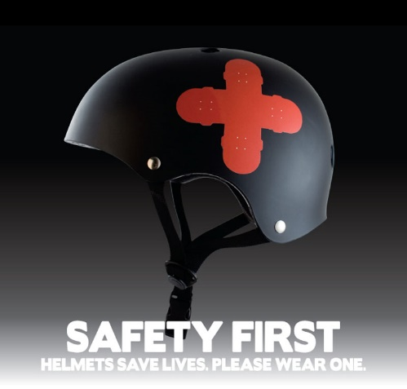
In-line Skating Safety Rules and Etiquette
Control your own safety by always using protective gear and properly functioning skates.
Always be in control of your skates and maintain a safe skating attitude. Do not show off.
Stay on the right side of the path. Always pass on the left and always call out a warning, “Passing on the left!”
Skate with the flow of traffic.
Do not wear headphones.
Learn and observe all traffic regulations. Remember to always yield to pedestrians.

Slide 28
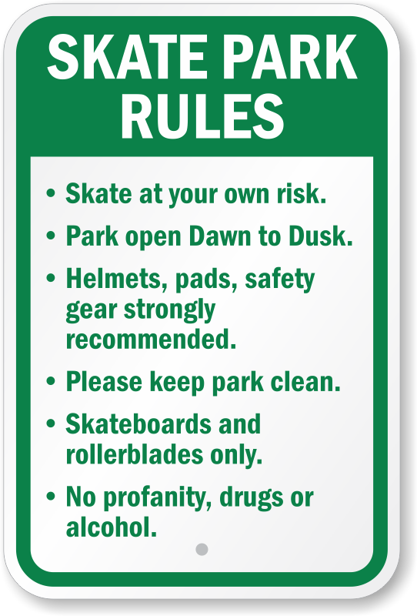
In-line Skating Safety Rules and Etiquette (cont.)
Stay away from anything on the road surface, such as water, oil, and rocks.
Avoid heavy traffic.
If you skate after dark, make sure your equipment and skates are well-covered with reflective materials that show up in the dark.
Skate only where you know you are welcome and not off limits.
Do not skate on private property without permission.
Never wear your skates inside a business or someone else’s home.

Slide 29
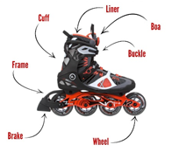
Parts and Functions of the In-Line Skate
Boa – A closure system which tightens laces through the turn of a dial.
Brake – A hard rubber attachment on the back of a skate.
Buckle – The buckle keeps your foot secure in your skate.
Cuff – The cuff provides support and helps add power.
Frame – The frame is what helps transfer energy to the wheels.
Liner – Inside the boot, the liner provides comfort and support.
Wheels – The wheels keep your skates rolling, but make sure they are the right ones for the location (indoor vs. outdoor).

Slide 30
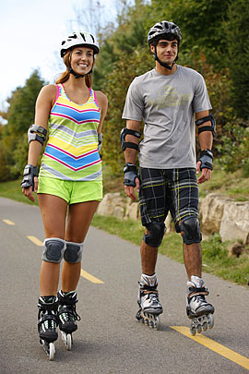
Required and Recommended Safety Equipment
Always wear a helmet. Not only is a helmet required by law in many cities and states, it will protect your head and make you more noticeable to motorists.
The most common skating injury involves injuries to the wrist. Wear wrist guards.
Elbow guards and knee pads are critical, especially as your learning to skate or new skating skills.

Slide 31
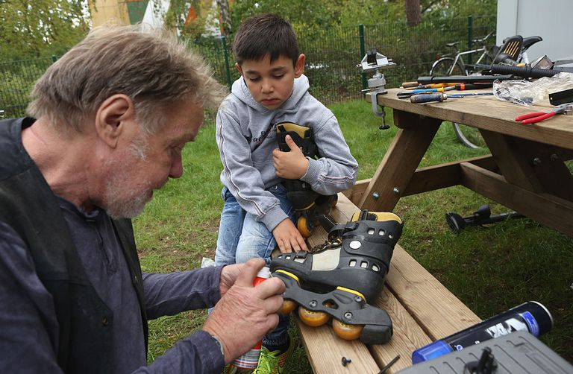
In-Line Skate Care
When you finish skating, pull the boot liner tongue back to its original position. Remove the liner from the plastic boot if it is wet.
Replace the heel brake when it wears to one-half inch or less. Brakes can burn up in an afternoon of downhill skating.
Rotate and replace wheels regularly. Dirt and grit may get into your wheel bearings so these must be cleaned regularly, too.
Read the booklet that comes with your skates. The manufacturer will give you specific instructions about maintaining your skates.

Slide 32
Requirement 2b In-Line Skating
Do the following:
Skate forward with smooth, linked strokes on two feet for at least 100 feet.
Skate forward and glide at least 15 feet on one skate, then on the other skate.
Stop on command on flat pavement using the heel brake.

Slide 33
Skate Forward with Linked Strokes and Glide
Click image for video

Slide 34
Stop Using Heel Brake
Click image for video

Slide 35
Requirement 2c In-Line Skating
Do the following:
Perform the forward crossover.
Perform a series of forward, linked swizzles for at least 40 feet.
Skate backward for at least 40 feet in a series of linked, backward swizzles.
From a strong pace, perform a lunge turn around an object predetermined by your counselor.
Perform a mohawk.

Slide 36
Forward Crossover
Click image for video

Slide 37
Forward, Linked Swizzles
Click image for video

Slide 38
Linked, Backward Swizzles
Click image for video

Slide 39
Lunge Turn
Click image for video

Slide 40
Mohawk
Click image for video

Slide 41
Requirement 2d In-Line Skating
Do the following:
Perform a series of at least four one-footed downhill slaloms on pavement with a gentle slope.
Describe how to pass a pedestrian or another skater from behind.
Describe at least three ways to avoid an unforeseen obstacle while skating.
Describe two ways to get on and off a curb, and demonstrate at least one of these methods.

Slide 42
Downhill Slaloms
Click image for video

Slide 43
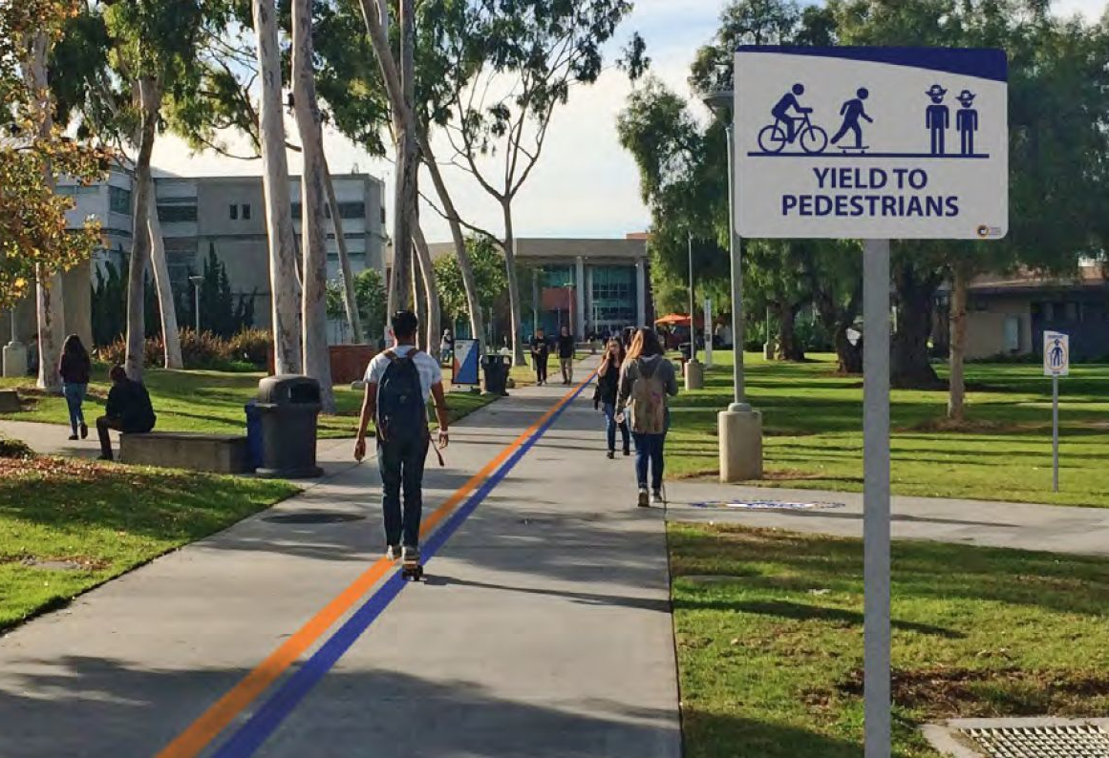
Passing a Pedestrian or Skater from Behind
Stay on the right side of the path.
Always pass on the left, and always call out a warning, “Passing on your left!”
Legally, you are a wheeled vehicle on in-line skates.
Learn and observe all traffic regulations which includes always yielding to pedestrians.

Slide 44
How to Avoid an Unforeseen Obstacle
Click image for video

Slide 45
Ways to Get On and Off a Curb
Click image for video

